Slide 1
第1章
线性规划

Slide 2
目录 CONTENTS
01
线性规划及其概念
02
线性规划模型求解及应用
03
投资的收益和风险

Slide 3
01
线性规划及其概念

Slide 4
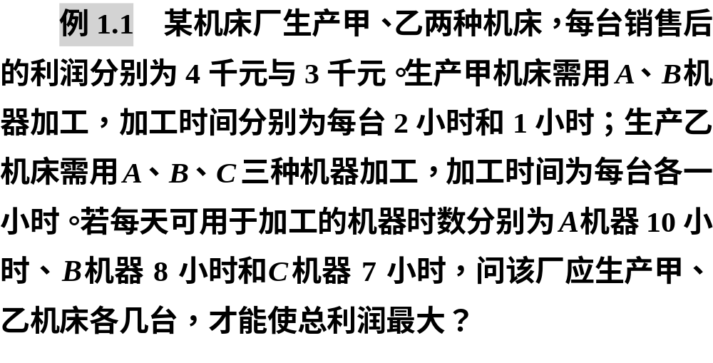
1.1 线性规划模型及其概念
1.引例

Slide 5




Slide 6



Slide 7
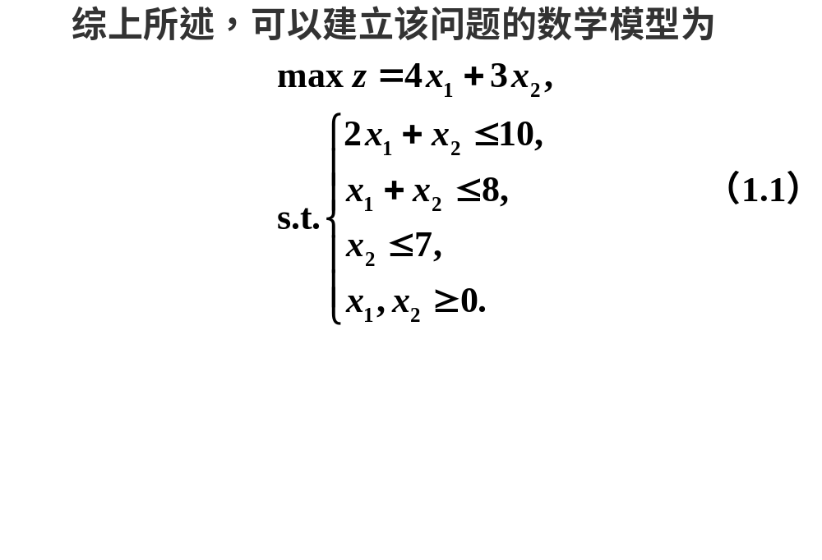

Slide 8



线性规划模型的三要素

Slide 9



2.建立线性规划模型的三个步骤

Slide 10
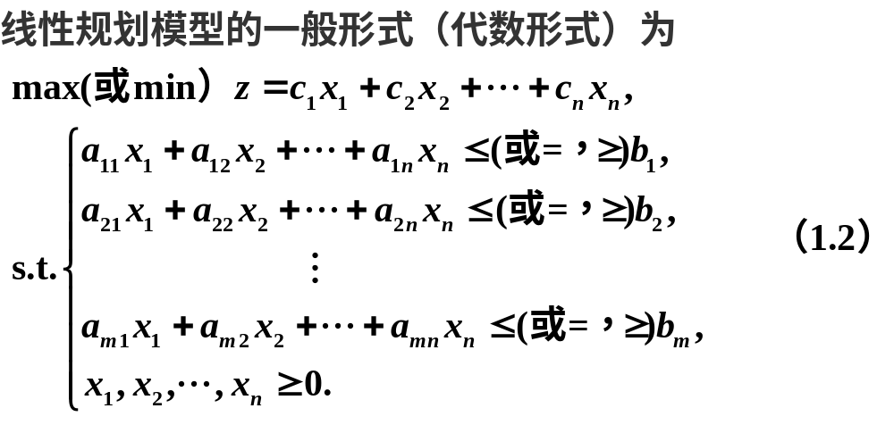
3.线性规划模型的形式

Slide 11
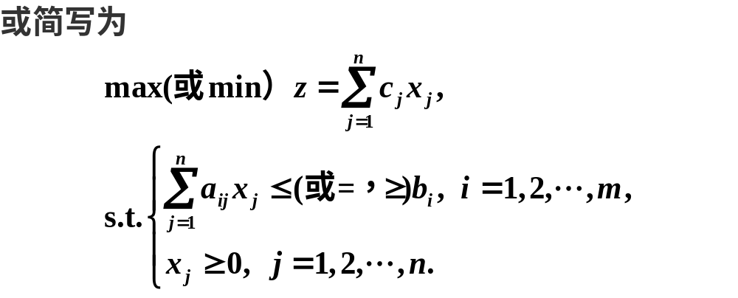
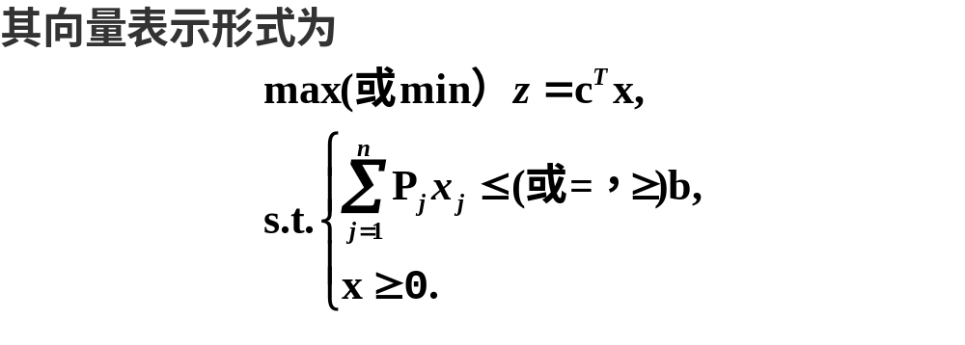

Slide 12
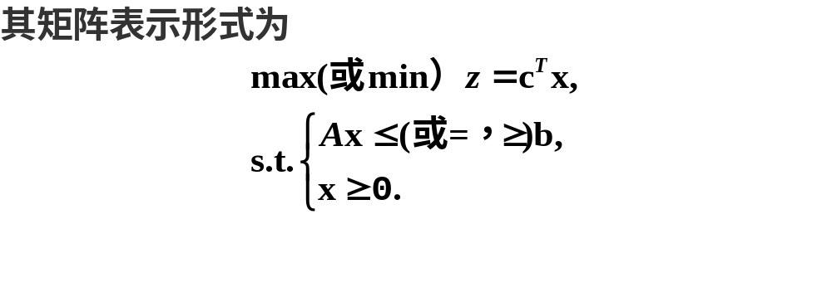
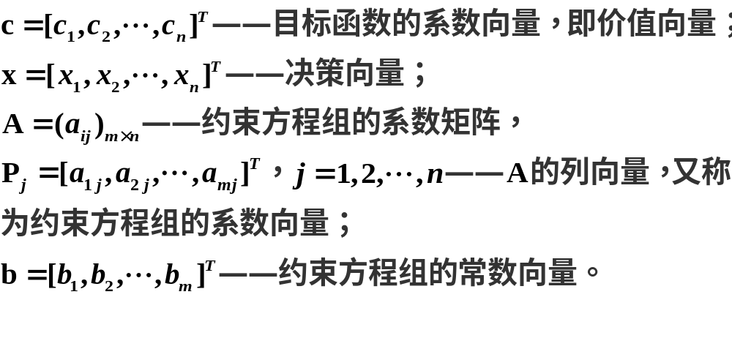

Slide 13
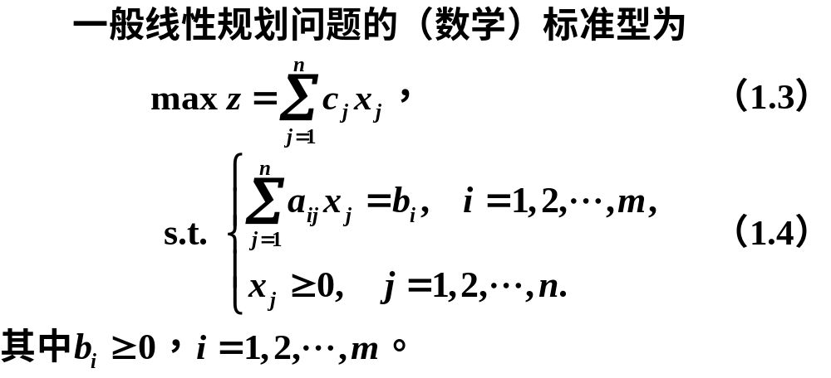
4.线性规划问题的解的概念

Slide 14



Slide 15



5.灵敏度分析

Slide 16



Slide 17



Slide 18
02
线性规划模型求解及应用

Slide 19

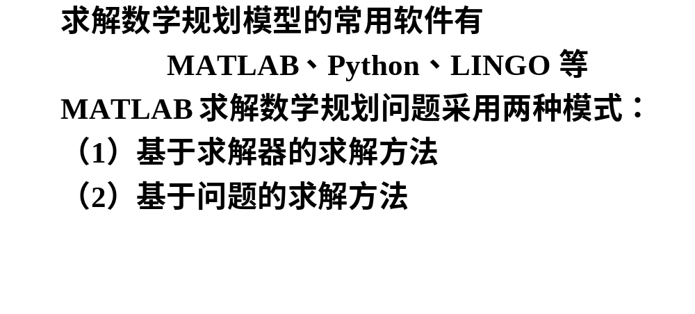
1.2 线性规划模型求解及应用

Slide 20
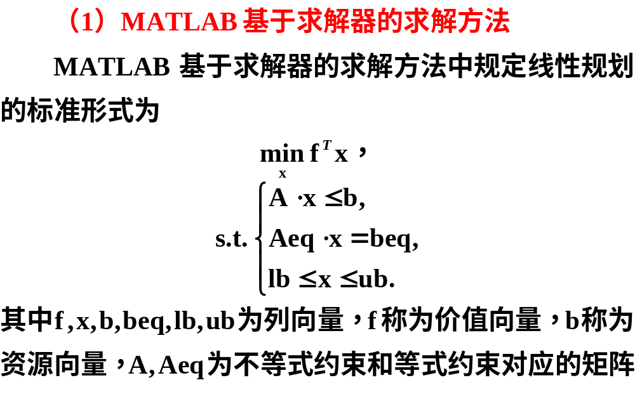
1.线性规划的MATLAB求解

Slide 21
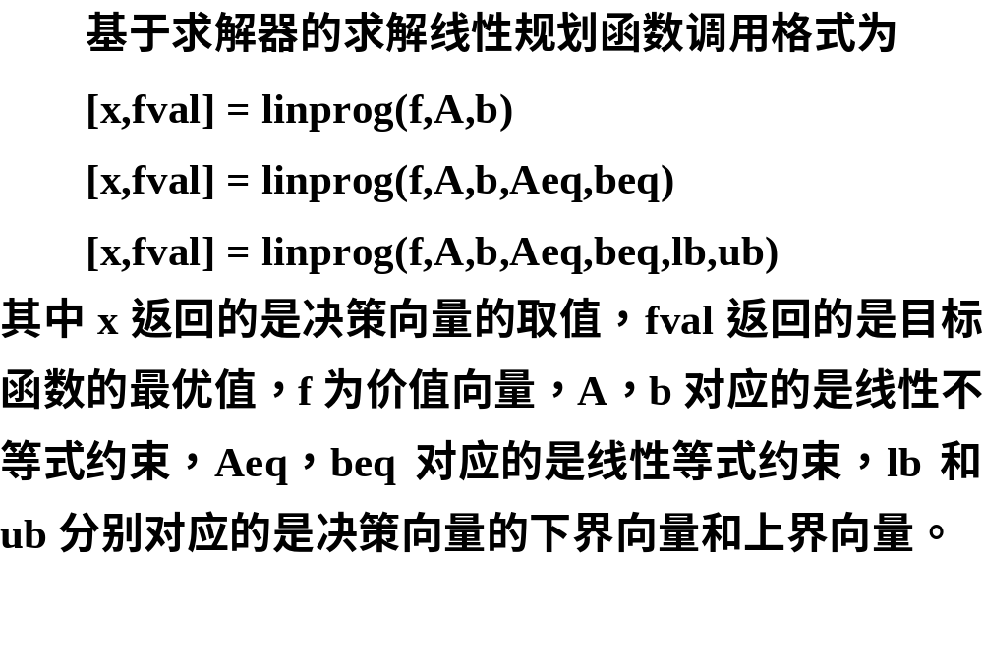

Slide 22

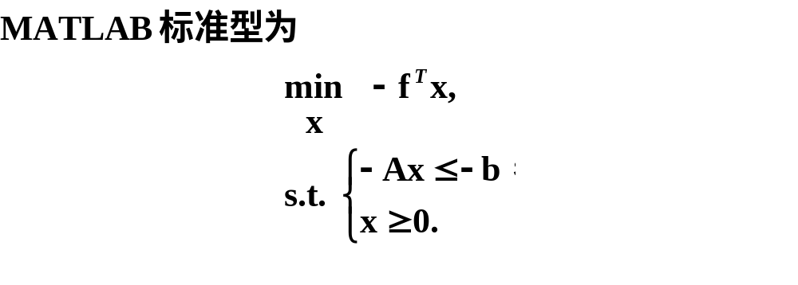

Slide 23
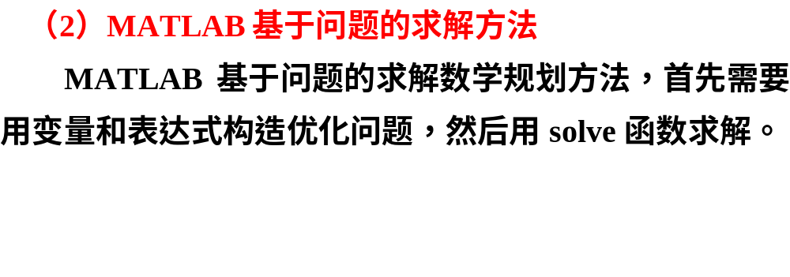

Slide 24
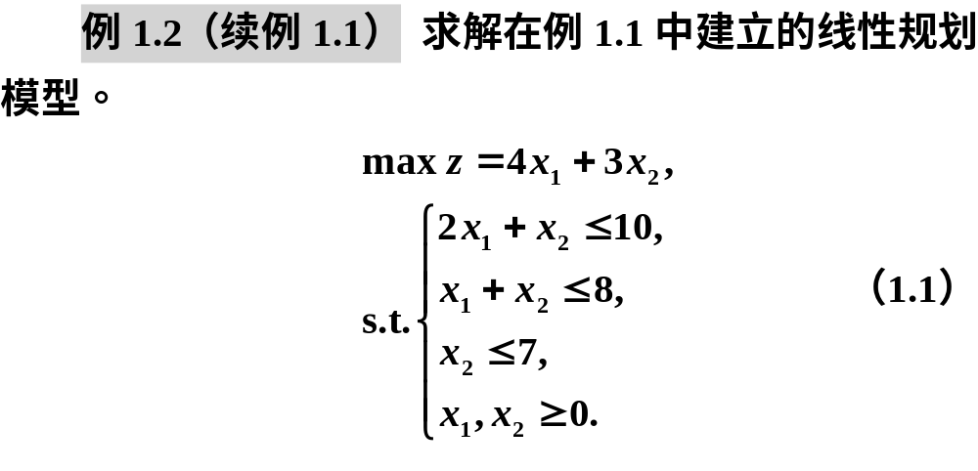
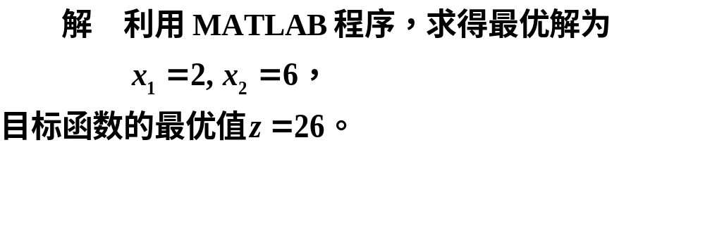

Slide 25

clc, clear
c = [4;3]; b = [10;8;7];
a = [2,1;1,1;0,1]; lb = zeros(2,1);
[x,fval] = linprog(-c,a,b,[],[],lb) %没有等号约束
y = -fval %目标函数为最大化

Slide 26

clc, clear
prob = optimproblem('ObjectiveSense', 'max')
c = [4;3]; b = [10;8;7];
a = [2,1;1,1;0,1]; lb = zeros(2,1);
x = optimvar('x',2,'LowerBound',0);
prob.Objective = c'*x;
prob.Constraints.con = a*x<=b;
[sol, fval, flage, out] = solve(prob)
sol.x %显示决策变量的值

Slide 27
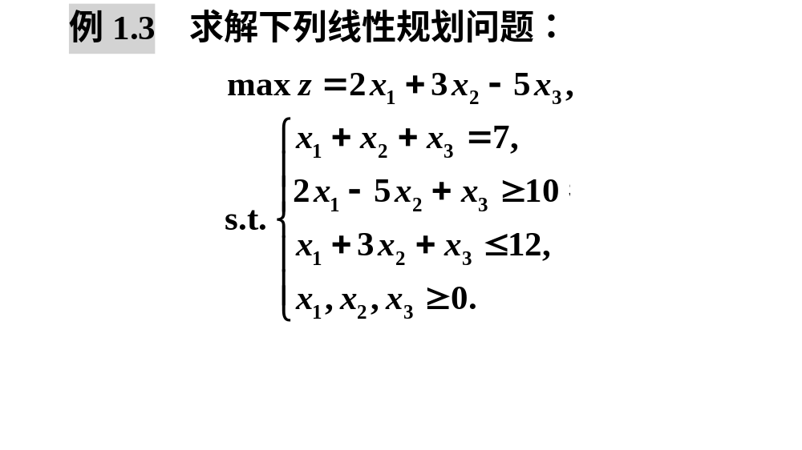

Slide 28
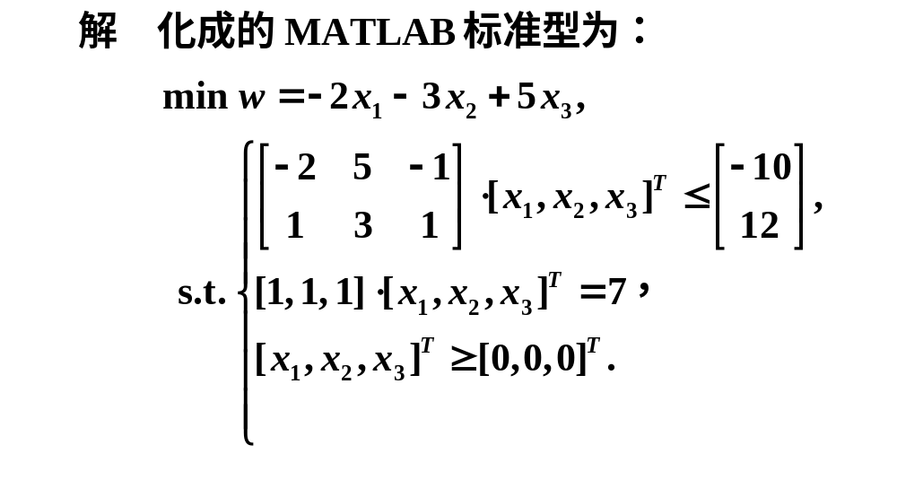
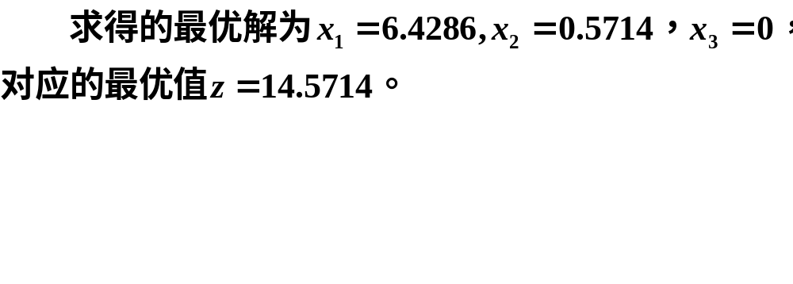

Slide 29

clc, clear, f=[-2; -3; 5];
a=[-2,5,-1;1,3,1]; b=[-10;12];
aeq=[1,1,1]; beq=7;
[x,y]=linprog(f,a,b,aeq,beq,zeros(3,1));
x, y=-y %目标函数最大化

Slide 30

clc, clear
prob = optimproblem('ObjectiveSense','max');
x = optimvar('x',3,'LowerBound',0);
prob.Objective = 2*x(1) + 3*x(2)-5*x(3);
prob.Constraints.con1 = x(1)+x(2)+x(3) == 7;
prob.Constraints.con2 = 2*x(1)-5*x(2)+x(3) >=10;
prob.Constraints.con3 = x(1)+3*x(2)+x(3) <=12;
[sol,fval,flag,out]= solve(prob), sol.x

Slide 31
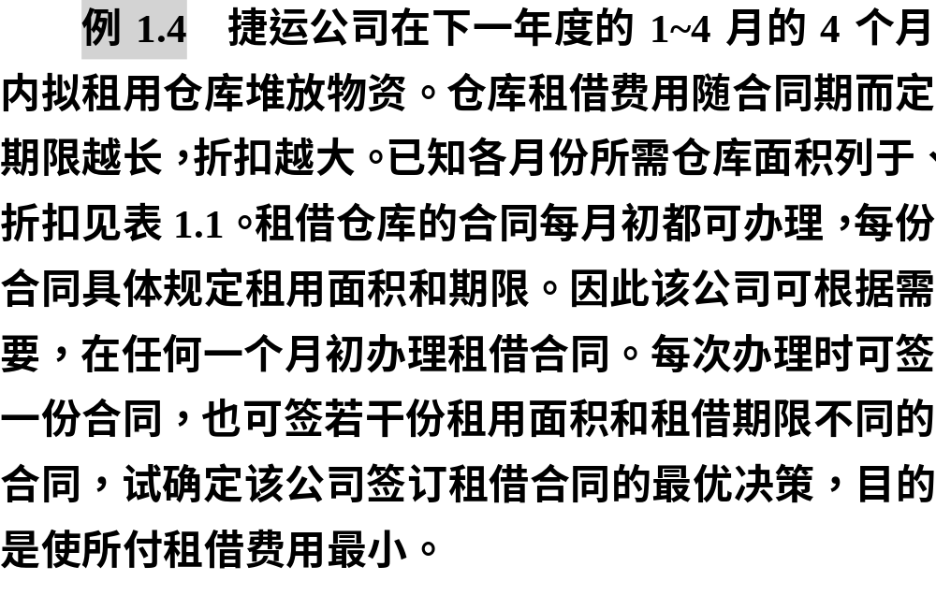
2.线性规划应用举例

Slide 32
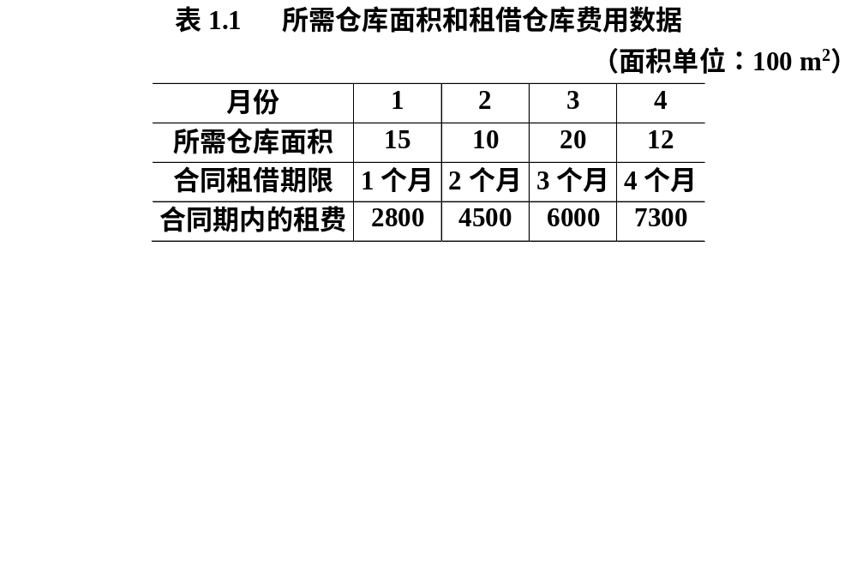

Slide 33
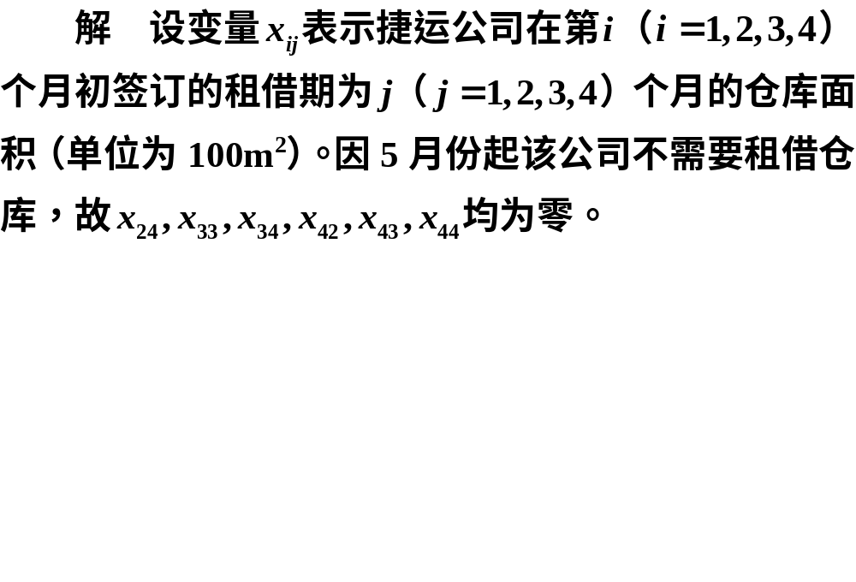

Slide 34
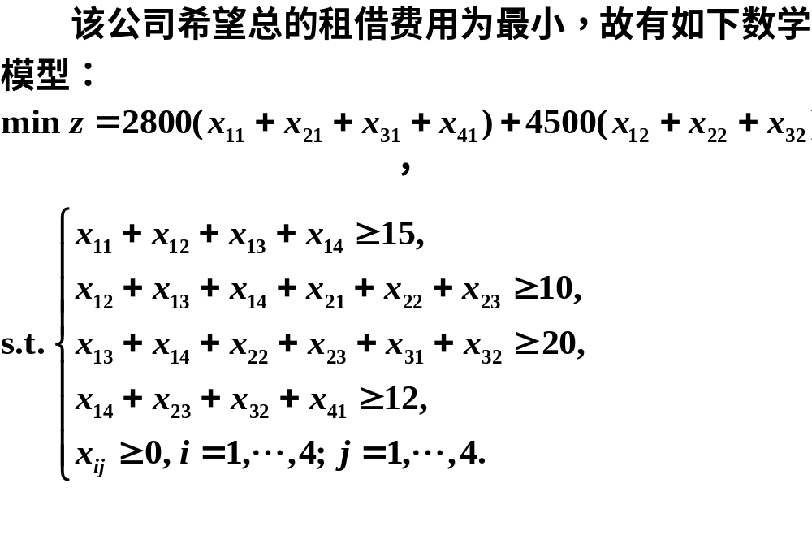

Slide 35

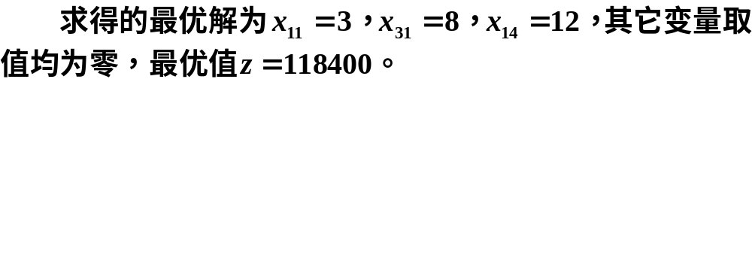

Slide 36
clc, clear
prob = optimproblem
x = optimvar('x',4,4,'LowerBound',0);
prob.Objective = 2800*sum(x(:,1))+4500*sum(x(1:3,2))+...
6000*sum(x(1:2,3))+7300*x(1,4);
prob.Constraints.con = [sum(x(1,:))>=15
sum(x(1,2:4))+sum(x(2,1:3))>=10
x(1,3)+x(1,4)+x(2,2)+x(2,3)+x(3,1)+x(3,2)>=20
x(1,4)+x(2,3)+x(3,2)+x(4,1)>=12];
[sol,fval,flag,out]= solve(prob), sol.x

Slide 37
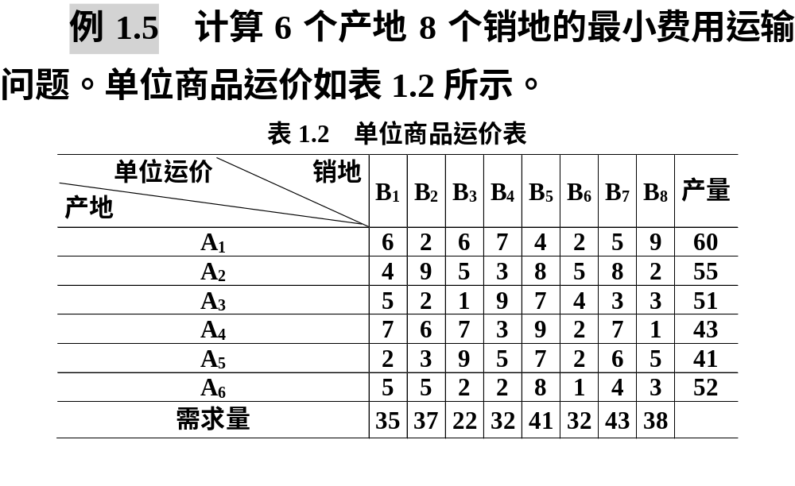
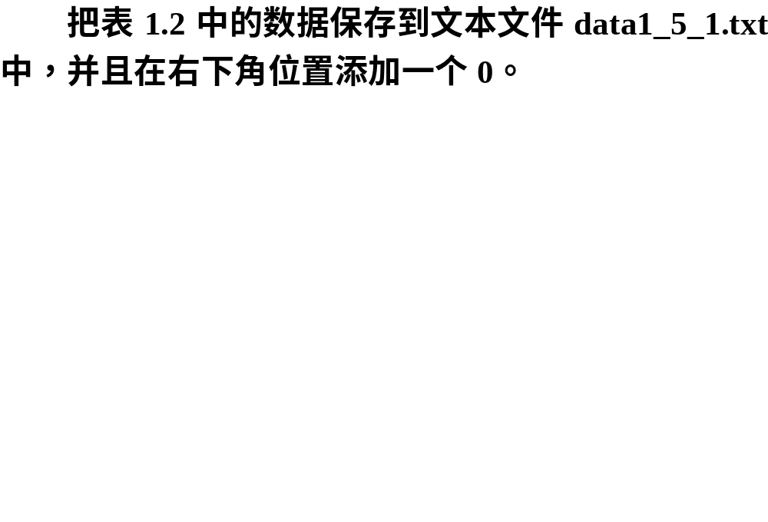

Slide 38

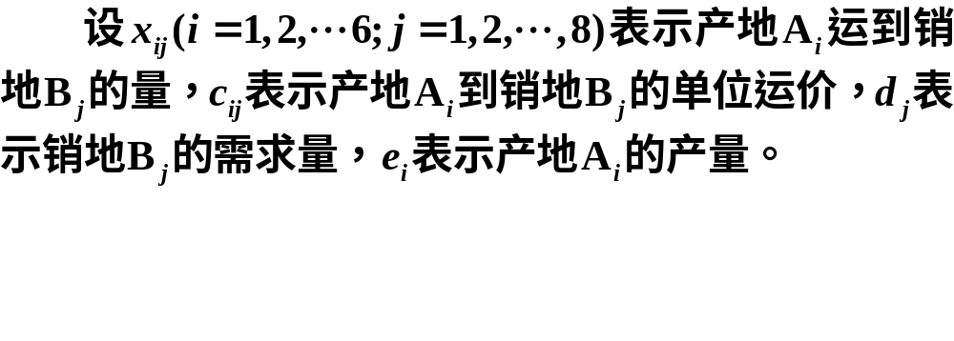


Slide 39
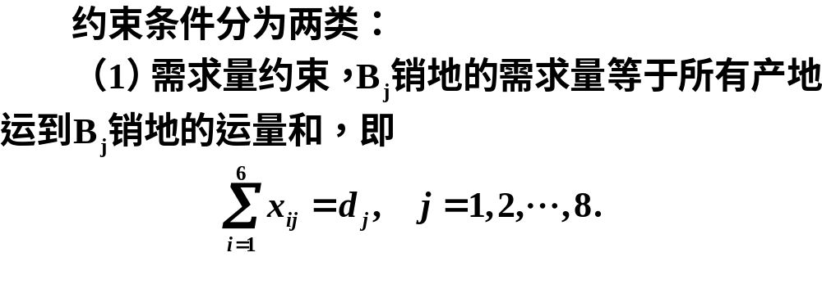
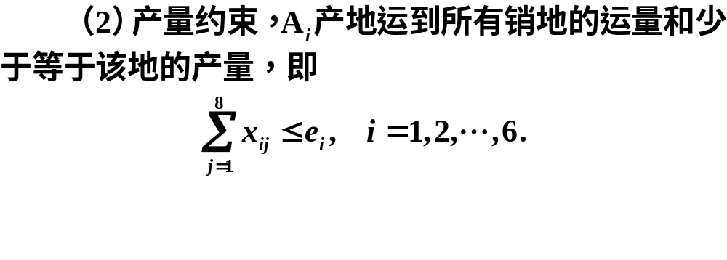

Slide 40
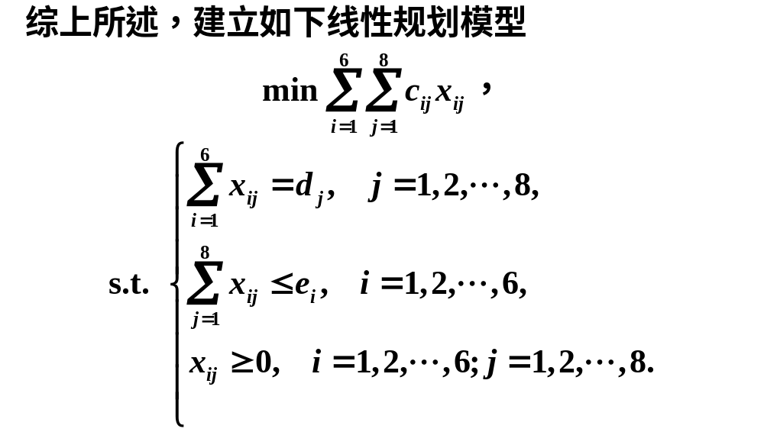

Slide 41
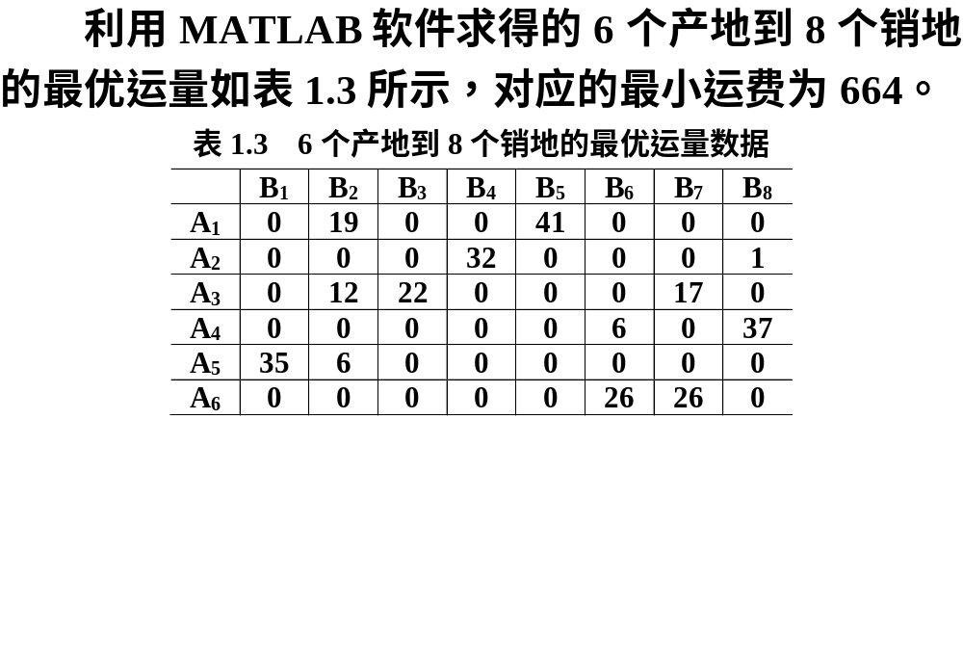

Slide 42
clc, clear, a = load('data1_5_1.txt');
c = a(1:end-1,1:end-1);
e = a(1:end-1,end); d = a(end,1:end-1);
prob = optimproblem;
x = optimvar('x',6,8,'LowerBound',0);
prob.Objective = sum(sum(c.*x));
prob.Constraints.con1 = sum(x,1) == d;
prob.Constraints.con2 = sum(x,2)<= e;
[sol,fval,flag,out]=solve(prob), xx=sol.x
writematrix(xx, 'data1_5_2.xlsx') %数据写到Excel文件，便于做表使用

Slide 43
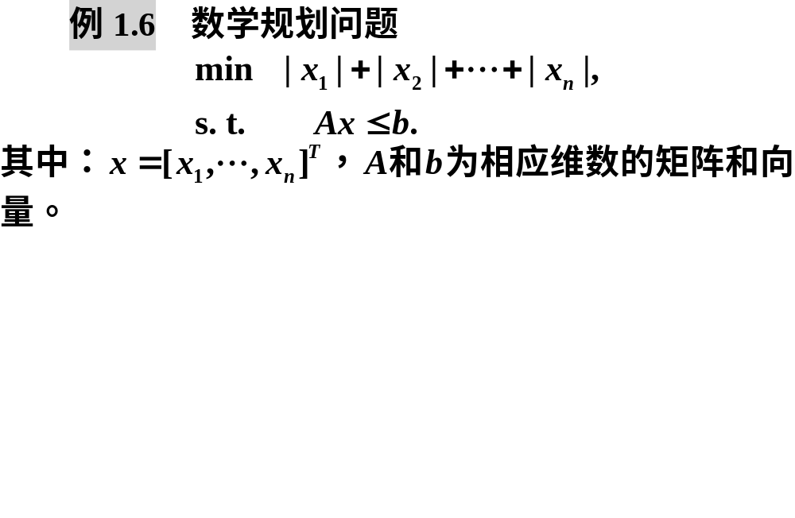
3.可以转化为线性规划的问题

Slide 44
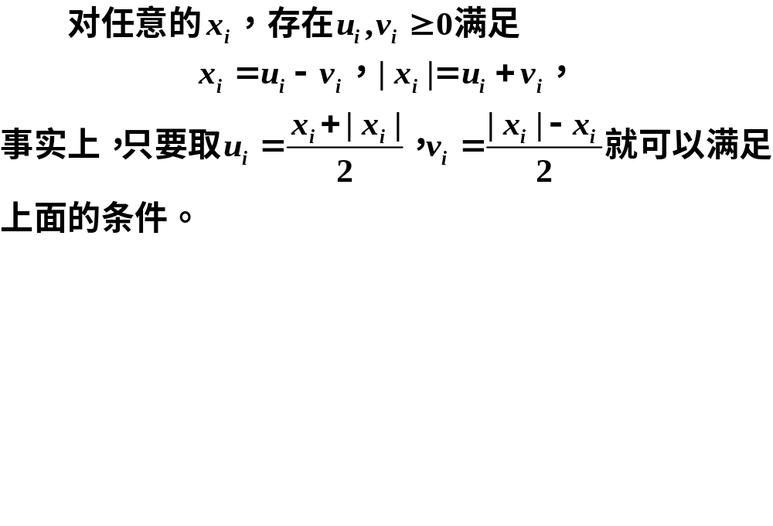

Slide 45
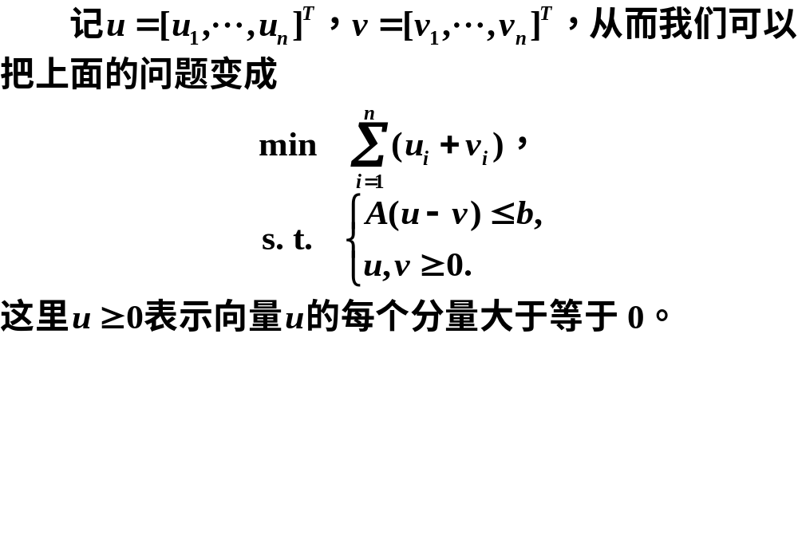

Slide 46
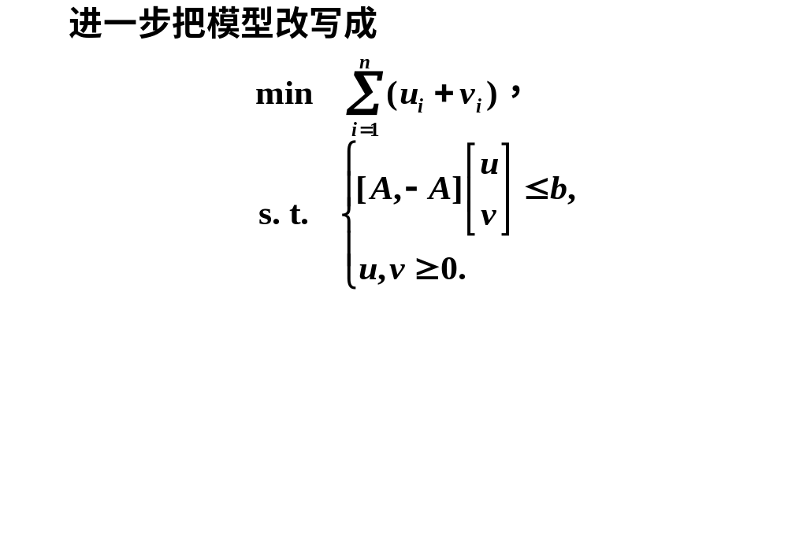

Slide 47
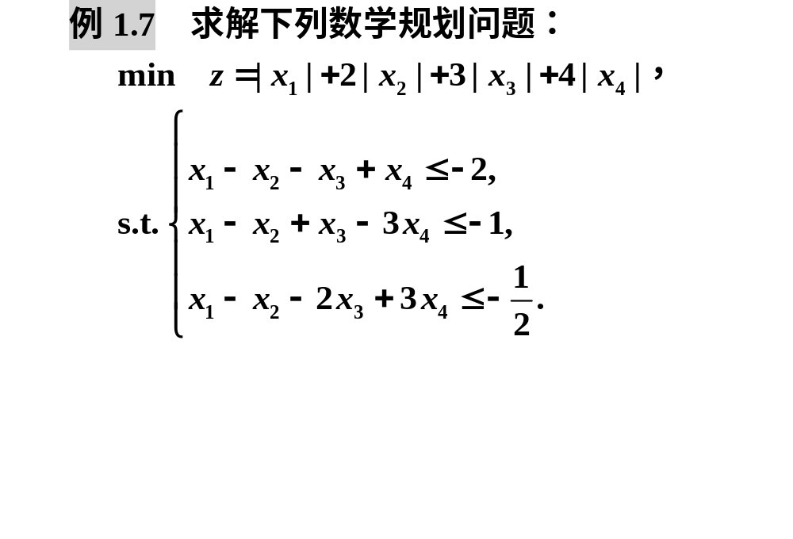

Slide 48
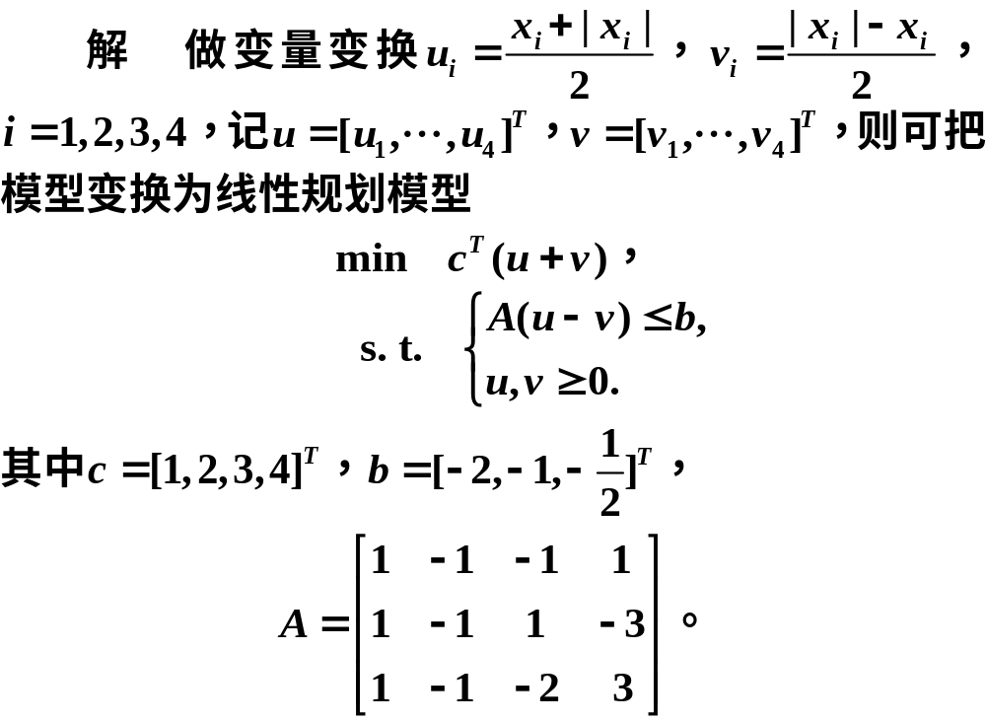

Slide 49
clc, clear
c = [1:4]'; b = [-2,-1,-1/2]';
a = [1,-1,-1,1;1,-1,1,-3;1,-1,-2,3];
prob = optimproblem;
u = optimvar('u',4,'LowerBound',0);
v = optimvar('v',4,'LowerBound',0);
prob.Objective = sum(c'*(u+v));
prob.Constraints.con = a*(u-v)<=b;
[sol,fval,flag,out]=solve(prob)
x = sol.u - sol.v

Slide 50
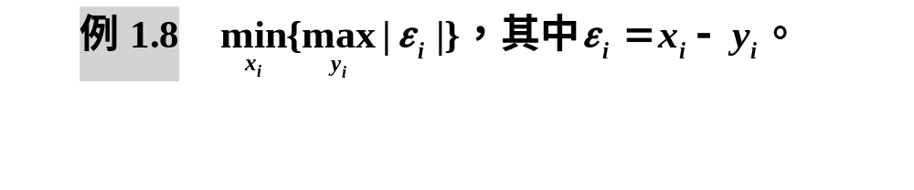
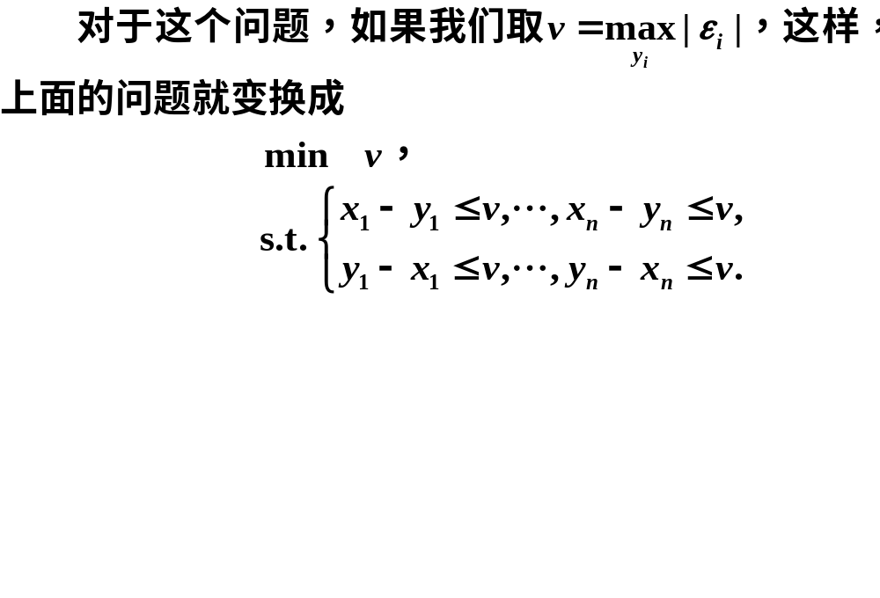

Slide 51
03
投资的收益和风险

Slide 52
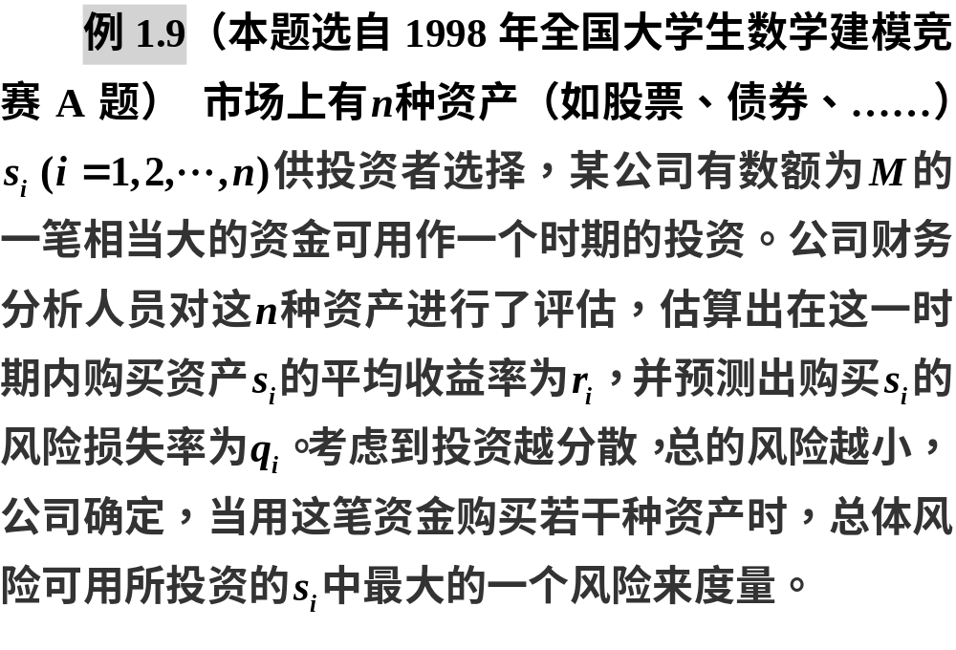

Slide 53

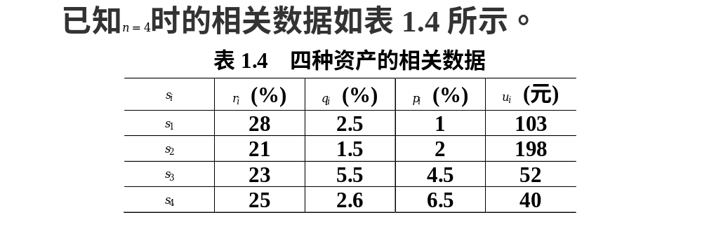

Slide 54


Slide 55
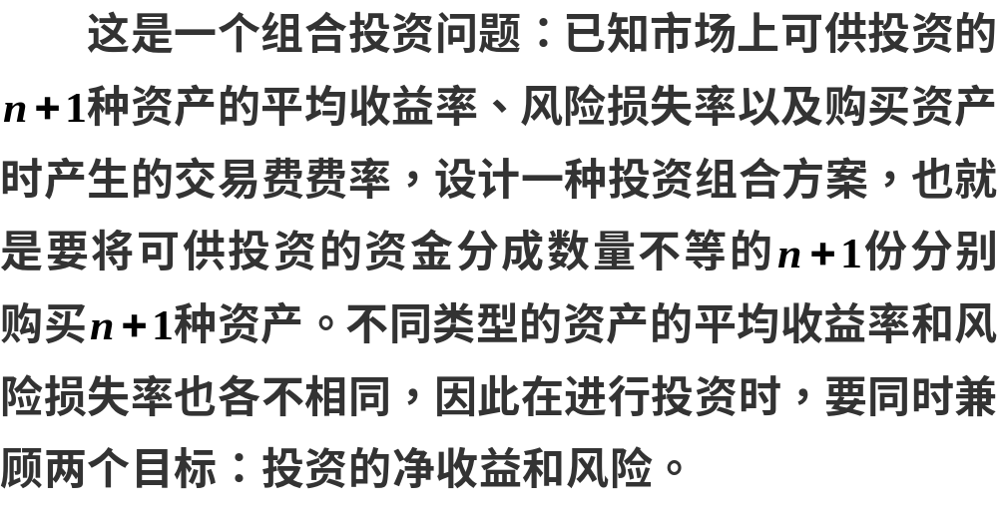
1.问题分析

Slide 56
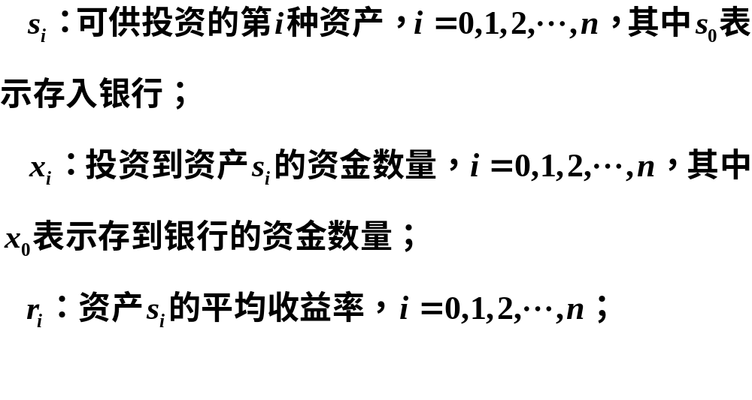
2.符号说明

Slide 57
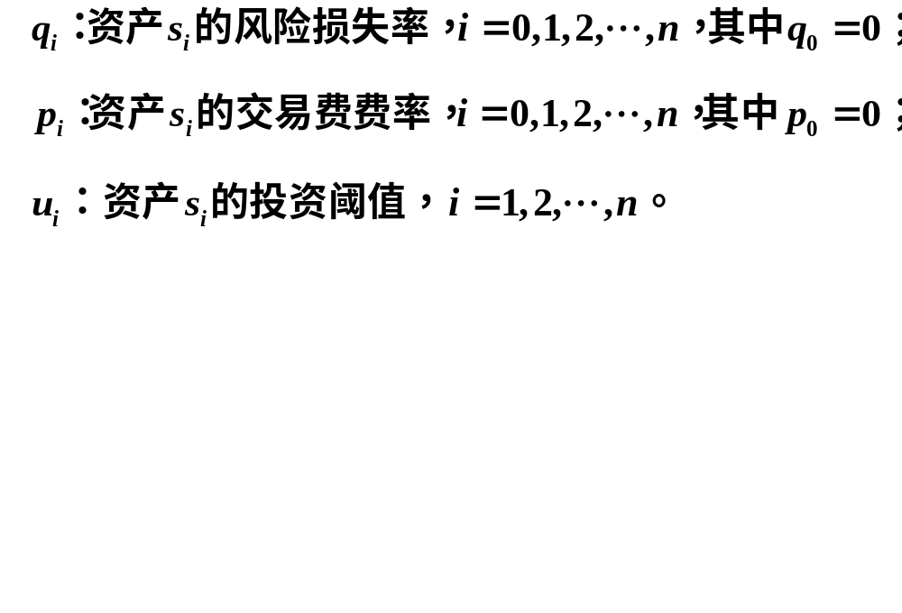

Slide 58
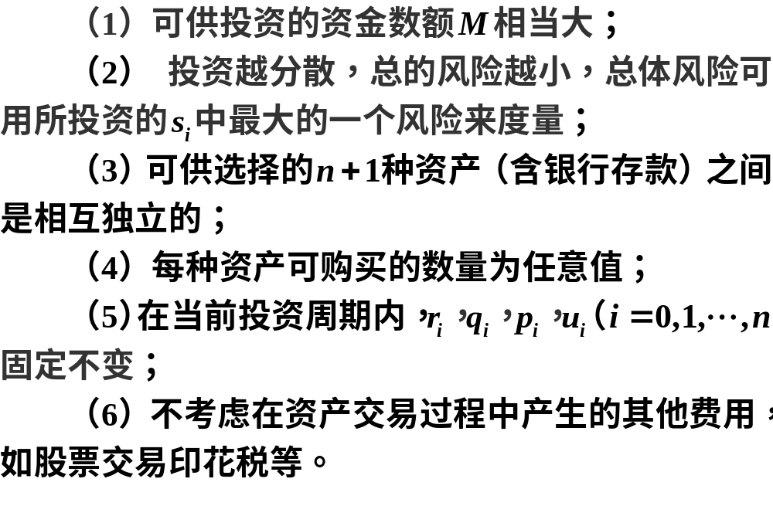
3.模型假设

Slide 59
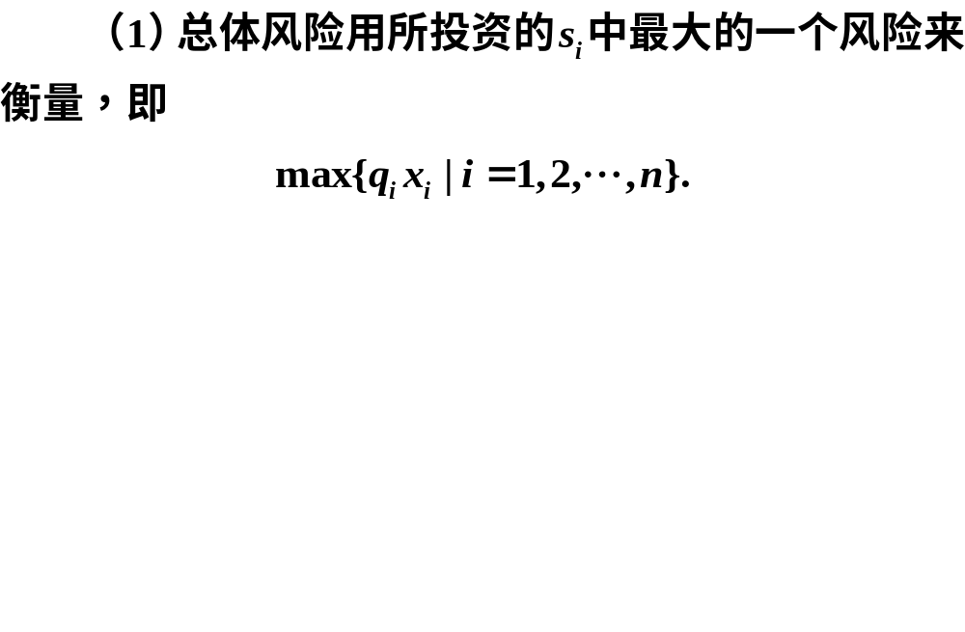
4.模型建立

Slide 60
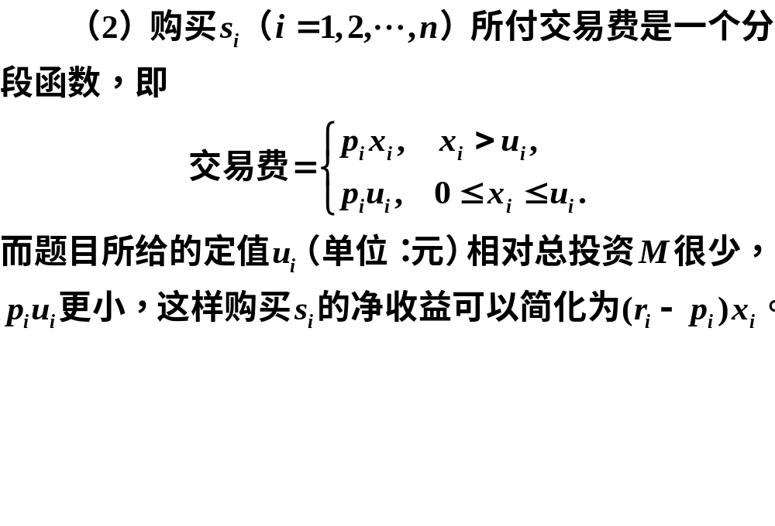

Slide 61
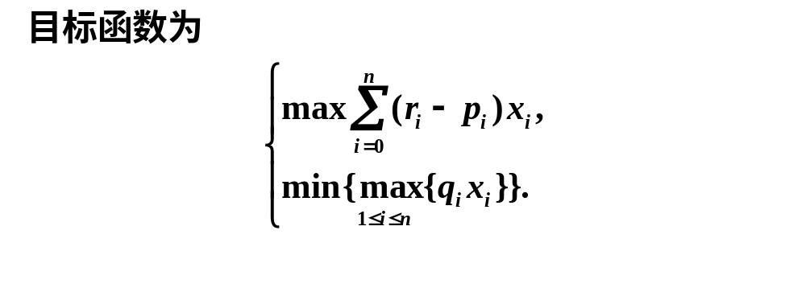
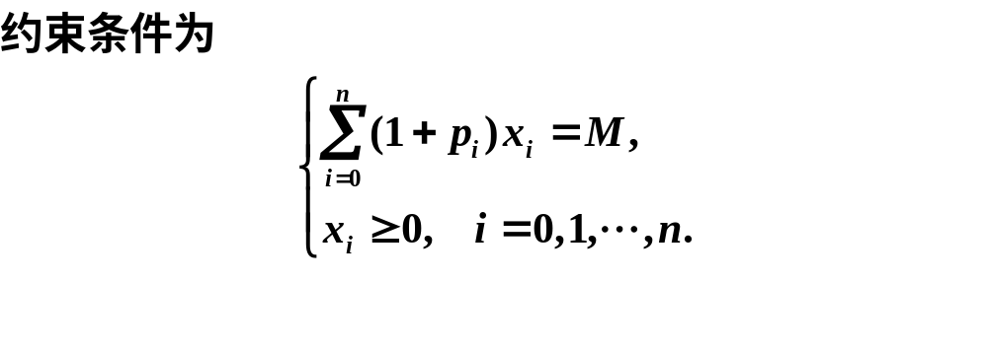

Slide 62
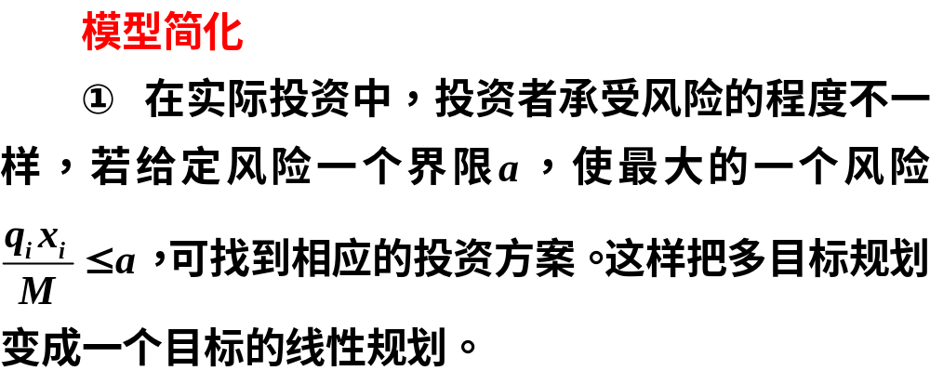

Slide 63
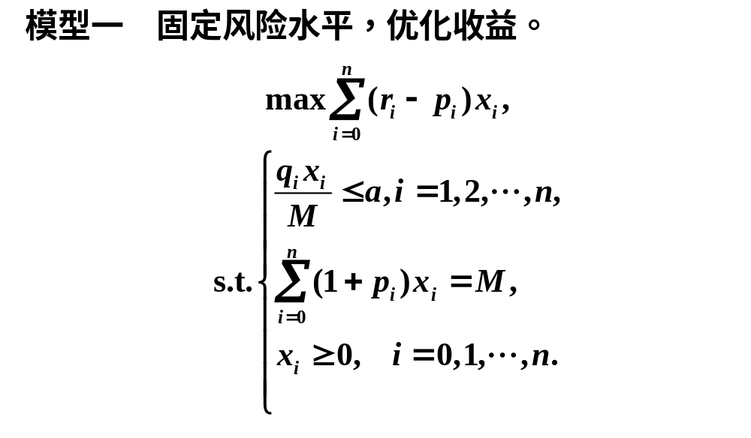

Slide 64



Slide 65


Slide 66


Slide 67

5.模型一的求解与分析

Slide 68


Slide 69
clc, clear, close all
prob = optimproblem('ObjectiveSense','max');
x = optimvar('x',5,1,'LowerBound',0);
c=[0.05,0.27,0.19,0.185,0.185]; %净收益率
Aeq=[1,1.01,1.02,1.045,1.065]; %等号约束矩阵
prob.Objective = c*x; M = 10000;
prob.Constraints.con1 = Aeq*x==M; %等号约束条件
q=[0.025,0.015,0.055,0.026]'; %风险损失率
a = 0; aa = []; QQ = []; XX = []; hold on
while a<0.05
prob.Constraints.con2 = q.*x(2:end)<=a*M;
[sol,Q,flag,out]= solve(prob);
aa = [aa; a]; QQ = [QQ,Q];
XX = [XX; sol.x']; a=a+0.001;
end
plot(aa, QQ, '*k')
xlabel('$a$','Interpreter','Latex'),
ylabel('$Q$','Interpreter','Latex','Rotation',0)

Slide 70



Slide 71


Slide 72


Slide 73

6.模型三的求解及分析

Slide 74


Slide 75


Slide 76


Slide 77


Slide 78


Slide 79
clc, clear, close all, format long g
M =10000; prob = optimproblem;
x = optimvar('x',6,1,'LowerBound',0);
r=[0.05,0.28,0.21,0.23,0.25]; %收益率
p=[0, 0.01, 0.02, 0.045, 0.065]; %交易费率
q=[0, 0.025, 0.015, 0.055, 0.026]'; %风险损失率
%w = 0:0.1:1
w = [0.766, 0.767, 0.810, 0.811, 0.824, 0.825, 0.962, 0.963, 1.0]
V = []; %风险初始化
Q = []; %收益初值化
X = []; %最优解的初始化
prob.Constraints.con1 = (1+p)*x(1:end-1)==M;
prob.Constraints.con2 = q(2:end).*x(2:end-1)<=x(end);
for i = 1:length(w)
prob.Objective = w(i)*x(end)-(1-w(i))*(r-p)*x(1:end-1);
[sol,fval,flag,out]=solve(prob);
xx = sol.x; V=[V,max(q.*xx(1:end-1))];
Q=[Q,(r-p)*xx(1:end-1)]; X=[X; xx'];
plot(V, Q, '*-'); grid on
xlabel('风险（元）'); ylabel('收益（元）')
end
V, Q, format

